Slide 1
Social Networking for Indiana Watershed Resources
Presented by:
Jessica Trensey
Neal Bennett

Slide 2
Problem
Information about watershed management/water quality improvement is scattered across the Internet.
Can be difficult for citizens to find the resources they need.
Several sites exist, but no single one covers all bases.

Slide 3
Project Overview
Goals:
Develop forums for IWLA affiliates (past and current members) & citizens to network
Provide centralized location for discussion about:
Events
Jobs
Watershed info./resources
Ideas for promotion of clean water
And more.

Slide 7
LinkedIn
Pros
Easy to use
Popular website, visible
Potential for variety of content
Cons
Can be difficult to establish strong group
Getting/keeping people engaged
May not appeal to non-IWLA affiliates

Slide 8
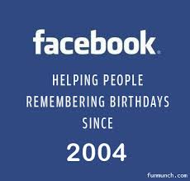

Slide 12
Questions?

